Slide 1
ClientCentral
SWENG-411 Final Project
Team:
Andrew Kuziel
Jennifer Lewis
Jordan Sharkey
Owen Powell

Slide 2
Introduction and Background
Current scheduling systems can be difficult to learn
Many of the current systems are outdated
Patients should be able to schedule their own appointments
ClientCentral was developed with the user in mind
The software is adaptable, allowing personalization for each doctor’s offices needs

Slide 3
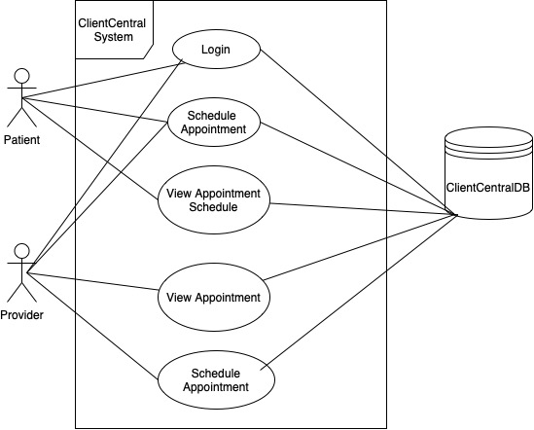
Use Case Diagram

Slide 4
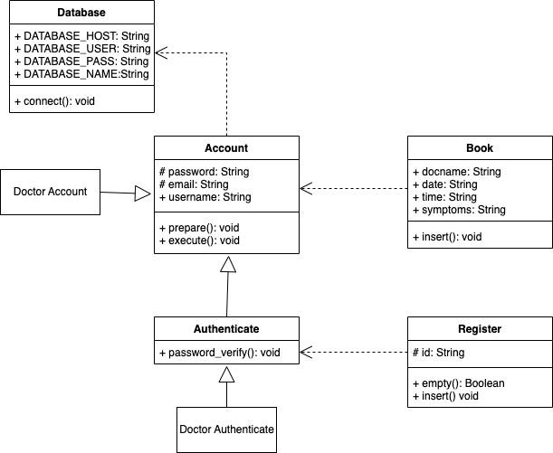
Class Diagram

Slide 5
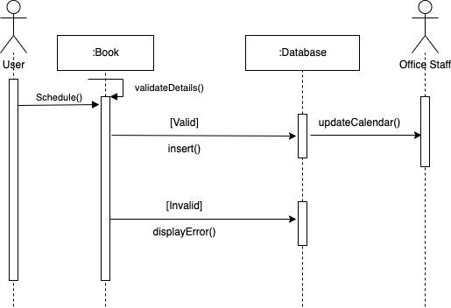
Scheduling Sequence Diagram

Slide 6
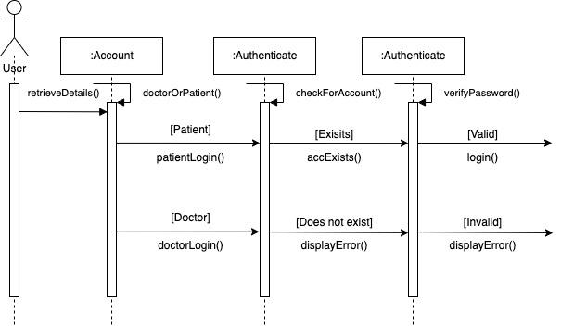
Login Sequence Diagram

Slide 7
Progress Update
We originally planned to use Java, Node.js, and SQL.
After our initial (rough draft) Java project was implemented, we found PHP allows a more seamless development process for accounts management and managing data.
Used Xampp to run MySQL and Apache Server.
We have the login use case completed. It allows both a patient and doctor to register and login to their account.
The project allows both patient and doctor to book an appointment.
Both types of users are able to view appointments.
Doctors can view all upcoming appointments.
Patient can view their personal upcoming appointments.
View a patient list on doctor’s account.
Created a MySQL database with patient, doctor, and appointment tables.
Security feature: Passwords are stored in hash in the database.

Slide 8
Lessons Learned:
Visual diagrams are vital to keeping a team on track
Learned more about PHP and MySQL work
The ability to pivot
The Importance of teamwork
ClientCentral
Pennsylvania State University - 2022
Team 6: Andrew Kuziel, Jennifer Lewis, Jordan Sharkey, Owen Powell

